Slide 1

Java File I/O
Program Design & Construction
Quan Bai

Slide 2
Applications
(C, C++, JAVA, …)
UI
Storage
CUI
GUI
File
DB
Java: AWT, Swing
File I/O
JDBC
2

Slide 3
File I/O Overview
I/O = Input/Output, here it is input to and output from programs
Inputs can be from:
Keyboard
Files
Etc.
Output can be:
Screen
Files
Etc.
Advantages of file I/O
permanent copy
output from one program can be input to another
input can be automated (rather than entered manually)

Slide 4
Binary vs. Text Files
All data and programs are ultimately just zeros and ones
each digit can have one of two values (0 or 1), hence binary
1 byte = 8 bits
Text files: the bits represent printable characters
one byte per character for ASCII, the most common code
for example, Java source files are text files
so is any file created with a "text editor“
Binary files: the bits represent other types of encoded information, such as executable instructions or numeric data

Slide 5
Text Files vs. Binary Files
Number: 127 (decimal)
Text file
Three bytes: “1”, “2”, “7”
ASCII (decimal): 49, 50, 55
ASCII (binary): 00110001, 00110010, 00110111
Binary file:
One byte (byte): 01111111
Two bytes (short): 00000000 01111111
Four bytes (int): 00000000 00000000 00000000 01111111

Slide 6
Buffering
Not buffered: each byte is read/written from/to disk as soon as possible
“little” delay for each byte
A disk operation per byte --- higher overhead
Buffered: reading/writing in “chunks”
Some delay for some bytes, e.g.:
Assume 16-byte buffers
Reading: access the first 4 bytes, need to wait for all 16 bytes are read from disk to memory
Writing: save the first 4 bytes, need to wait for all 16 bytes before writing from memory to disk
A disk operation per a buffer of bytes---lower overhead

Slide 7



Streams
Stream: an object that either delivers data to its destination (screen, file, etc.) or that takes data from a source (keyboard, file, etc.)
it acts as a buffer between the data source and destination
Input stream: a stream that provides input to a program
E.g., System.in is an input stream
Output stream: a stream that accepts output from a program
E.g., System.out is an output stream
Examples:
System.out.println(“Hi”) connects a program to the screen
Program
Streams

Slide 8
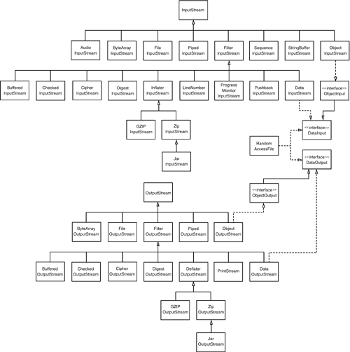
Stream Zoo in Java
Java has a whole zoo of more than 60 different stream types
CORE Java Vol. 2 (9th edition)

Slide 9
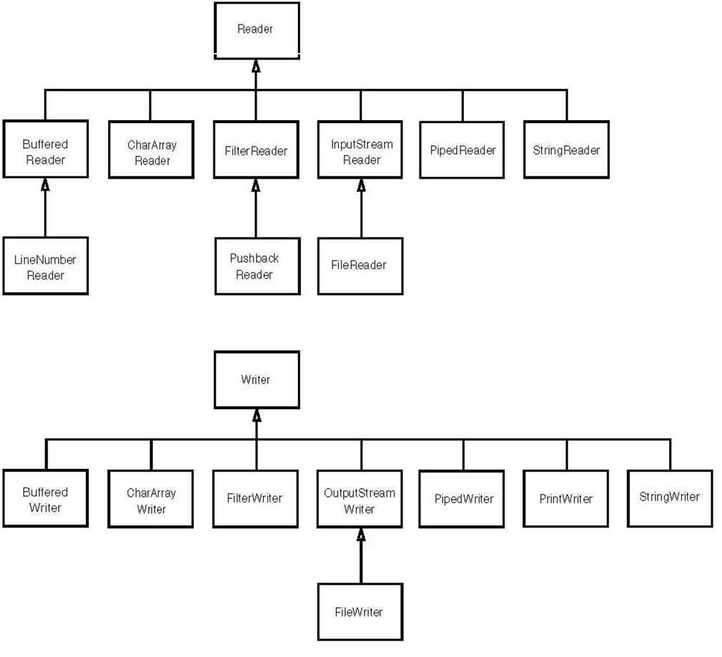
Reader and Writer
For Unicode text, you can use subclasses of the abstract classes Reader and Writer
The basic methods of the Reader and Writer classes are similar to those for InputStream and OutputStream
Reader & Writer hierarchy
CORE Java Vol. 2

Slide 10
Java I/O
Standard IO:
System.out.println("a line"); to send a line to the standard output, i.e., the screen, unless you redirect standard output
public class RedirectSysOut {
public static void main(String[] args) throws FileNotFoundException
{
PrintStream stream1 = System.out;
File aFile=new File("sysout.log");
PrintStream stream2 = new PrintStream(new FileOutputStream(aFile));
System.out.println("1");
System.setOut(stream2);
System.out.println("2");
System.setOut(stream1);
System.out.println("3");
}
}

Slide 11
Text File I/O
Important classes for text file output (to the file)
FileWriter
FileOutputStream
BufferedWriter
PrintWriter
Important classes for text file input (from the file):
FileReader
BufferedReader
FileInputStream
FileWriter and FileReader take file names as arguments.
PrintWriter and BufferedReader provide useful methods for easier writing and reading.
FileReader
Hello.
txt
FileOutputStream
FileWriter
Makes it more efficient and convenient
BufferedWriter
FileWriter
PrintWriter
Makes it more convenient

Slide 12
Text File Output
To open a text file for output: connect a text file to a stream for writing
FileOutputStream fOutStream = new FileOutputStream("out.txt");
PrintWriter pWriter = new PrintWriter(fOutStream );
Or:
PrintWriter outputStream = new PrintWriter(new FileOutputStream("out.txt"));
What happened is:
create a PrintWriter object which uses FileOutputStream to open a text file
FileOutputStream “connects” PrintWriter to a text file.
Memory
Disk
out.txt
PrintWriter
FileOutputStream

Slide 13
Example:
public static void main(String[] args)
{
PrintWriter outputStream = null;
try
{
outputStream = new PrintWriter(new FileOutputStream("out.txt"));
for (int count = 1; count <= 3; count++)
outputStream.println(count);
System.out.println("... written to out.txt.");
outputStream.close();
} catch(FileNotFoundException e){
System.out.println("Error opening the file out.txt."+ e.getMessage());
}
}
}
Opening the file
Writing to the file
The println method is used with two different streams: outputStream and System.out

Slide 14
Overwriting a File
In the previous example:
Opening an output file creates a new file if it does not already exist
If the file is existing, it will overwrite the file, i.e., data in the original file is lost

Slide 15
Appending to a Text File
To add/append to a file instead of replacing it, use a different constructor for FileOutputStream:
outputStream =
new PrintWriter(new FileOutputStream("out.txt", true));
Example:
outputStream = new PrintWriter(new FileOutputStream("out.txt”));
for (int count = 1; count <= 10; count++)
outputStream.println(count);
outputStream.close();
outputStream = new PrintWriter(new FileOutputStream("out.txt”, true));
for (int count = 1; count <= 10; count++)
outputStream.println(count);
outputStream.close();

Slide 16
Closing a File
After writing a file, you should close the FileOutputStream and the PrintWriter
fileOutputStream.close();
outputStream.close();
Why close the file?
To make sure it is closed if a program ends abnormally (it could get damaged if it is left open)
Flush the stream
Calling close() on a wrapper stream should close the child stream.
E.g., if a PrintWriter is closed, the FileOutputStream it linked with is also closed.

Slide 17
Example:
FileOutputStream fos=new FileOutputStream("out.txt");
PrintWriter outputStream = new PrintWriter(fos);
for (int count = 1; count <= 3; count++)
{
outputStream.println(count);
}
outputStream.close();
outputStream = new PrintWriter(fos);
for (int count = 5; count <= 8; count++)
{
outputStream.println(count);
}
outputStream.close();
What will be in out.txt???
1
2
3
5
6
7
8
5
6
7
8
1
2
3
null
Both the PrintWriter and FileOutputStream have been closed!!!

Slide 18
Text File Input
To open a text file for input: connect a text file to a stream for reading
a BufferedReader object, which uses FileReader to open a text file
FileReader “connects” BufferedReader to the text file
FileReader s = new FileReader(“input.txt");
BufferedReader inStream = new BufferedReader(s);
Or:
BufferedReader inStream =
new BufferedReader(new FileReader(“input.txt"));
Memory
BufferedReader
FileReader
Disk
input.txt

Slide 19
Methods for BufferedReader
readLine(): read a line into a String
read(): read the ASCII code of a character in the text file (at a time)
close BufferedReader stream

Slide 20
Testing for End of File in a Text File
When readLine() tries to read beyond the end of a text file it returns the special value null
so you can test for null to stop processing a text file
Read() returns -1 when it tries to read beyond the end of a text file

Slide 21
Example:
try
{
FileReader fr=new FileReader("input.txt“);
BufferedReader inputStream = new BufferedReader(fr);
String line = null;
while((line=inputStream.readLine())!=null)
System.out.println(line);
inputStream.close();
}
catch(FileNotFoundException e)
{
System.out.println("File not found.");
}
catch(IOException e)
{
System.out.println("Error reading from file " + fileName);
}
Read a line from the file
Check whether reached the end

Slide 22
StringTokenizer
There are methods to read a line and a character, but not just a single word
StringTokenizer:
Token: a block of (useful) text
Delimiter: is a character used to separate items of data
E.g., CSV files: comma-delimited
Create a StringTokenizer instance
you can specify delimiters (the character or characters that separate words)
the default delimiters are: space, tab, and newline
StringTokenizer(String str, String delim, boolean returnDelims)
The string to be separated
The delimiters
Whether return delimiters as tokens

Slide 23
Example: Display the words separated by any of the following characters: space, new line (\n), period (.) or comma (,).
String str = “abc,.def,hij,klm”;
StringTokenizer st= new StringTokenizer(str, “ \n.,");
while(st.hasMoreTokens())
{
System.out.println(st.nextToken());
}
abc
def
hij
klm
StringTokenizer st= new StringTokenizer(str, " \n.,”, true);
abc
,
.
def
,
hij
klm

Slide 24
Read an integer by using BufferedReader
No methods to read numbers directly
Read numbers as Strings and then convert them:
try{
String line =inputStream.readLine();
int value = Integer.parseInt(line);
}
catch(java.lang.NumberFormatException e){ … }
catch(IOException e){ …}

Slide 25
Input with Scanner
Java 1.5 introduced the Scanner class which simplifies console input.
It can also be used to read from files and Strings (among other sources)
Scanner is in the Java.util package:
import java.util.Scanner;

Slide 26
Creating Scanner objects
We can create a Scanner object by invoking several different constructors.
Scanner(File source) Constructs a new Scanner that produces values scanned from the specified file.
Scanner(InputStream source) Constructs a new Scanner that produces values scanned from the specified input stream.
Scanner(String source) Constructs a new Scanner that produces values scanned from the specified string.
…
Example (read a line from keyboard):
Scanner sc = new Scanner (System.in);

Slide 27
Next Methods
String next() Finds and returns the next complete token from this scanner.
boolean nextBoolean() Scans the next token of the input into a boolean value and returns that value.
double nextDouble() Scans the next token of the input as a double.
float nextFloat() Scans the next token of the input as a float.
int nextInt() Scans the next token of the input as an int.
String nextLine() Advances this scanner past the current line and returns the input that was skipped.
long nextLong() Scans the next token of the input as a long.
short nextShort() Scans the next token of the input as a short.
Example:
Scanner sc = new Scanner(System.in);
int i=sc.nextInt();

Slide 28
hasNext methods
boolean hasNext() Returns true if this scanner has another token in its input.
boolean hasNextBoolean() Returns true if the next token in this scanner's input can be interpreted as a boolean value using a case insensitive pattern created from the string "true|false".
boolean hasNextDouble() Returns true if the next token in this scanner's input can be interpreted as a double value using the nextDouble() method.
boolean hasNextInt() Returns true if the next token in this scanner's input can be interpreted as an int value in the default radix using the nextInt() method.
boolean hasNextLine() Returns true if there is another line in the input of this scanner.
boolean hasNextLong() Returns true if the next token in this scanner's input can be interpreted as a long value in the default radix using the nextLong() method.
boolean hasNextShort() Returns true if the next token in this scanner's input can be interpreted as a short value in the default radix using the nextShort() method.
…

Slide 29
Example
Scanner sc = new Scanner (System.in);
System.out.print ("Enter first int: ");
while (sc.hasNextInt())
{
int i = sc.nextInt();
System.out.println("You entered " + i);
System.out.print ("Enter another int: ");
}

Slide 30
Delimiters in Scanner
The Scanner class basically parses input from the source into tokens by using delimiters to identify the token boundaries (similar with StringTokenizer)
Default delimiters are: space, tab, new line
Set your own delimiters:
useDelimiter(“delimeter1|delimiter2|delimiter3…”)
“*” means the repeating of a character will be considered as ONE delimiter
Put \\ in front of a special character, e.g., \\*
abc
dec
xyz
txt
aaa
bbb
String str="abc,,,,,dec. xyz:txt*****aaa.bbb";
Scanner sc = new Scanner(str);
sc.useDelimiter(",,*|\\. *|: *|\\*\\**");
while(sc.hasNext()){
System.out.println(sc.next());
}

Slide 31
Path Operations
Path and Files classes were added in Java 7 for more convenient file operations
Path and Paths:
Path: an interface under java.nio.file. A Path is a sequence of directory names, optionally followed by a file name
Absolute path: “C:\home” (Windows)
Relative path: “home\files”
Paths: consists exclusively of static methods that return a Path by converting a path string
Path absolute= Paths.get(“C:”, “dir1”,”dir2”,”text.txt”);
Path relative= Paths .get(“dir1”, “dir2”,”text.txt”);
Return a Path instance
Provide a method for getting a Path instance

Slide 32
Path Operations (cont.)
Some other useful methods
Path getFileName()
Path getParent()
Path getRoot()
String toString()
Example:
Outputs:
C:\dir1\dir2\test.txt
test.txt
C:\
C:\dir1\dir2
Path p1=Paths.get("C:","dir1","dir2","test.txt");
String str=p1.toString();
System.out.println(str);
Path p2=p1.getFileName();
System.out.println(p2.toString());
Path p3=p1.getRoot();
System.out.println(p3.toString());
Path p4=p1.getParent();
System.out.println(p4.toString());

Slide 33
File Operations
File
Under java.io.File
An abstract representation of file and directory pathnames.
Some useful methods:
boolean canRead()
boolean canWrite()
boolean canExecute()
boolean exists()
File aFile= new File (“C:\\dir1\\test.txt”);

Slide 34
File Operations (cont.)
Files
Under java.nio.file.Files
This class consists exclusively of static methods that operate on files, directories, or other types of files.
In most cases, the methods defined here will delegate to the associated file system provider to perform the file operations.
Some useful methods:
Path createFile(Path path)
Path createDirectories(Path dir)
void delete(Path path)
boolean exists(Path path)
boolean deleteIfExists(Path path)

Slide 35
File Operations (cont.)
Example: create a new directory and a new file from Java, and write to the file
Path p1=Paths.get("C:","dir1","dir2","test.txt");
try {
Files.createDirectories(p1.getParent());
File aFile=new File(p1.toString());
if(!aFile.exists()){
Files.createFile(p1);
}
PrintWriter pw=new PrintWriter(aFile);
pw.write("test test1 test2");
pw.flush();
pw.close();
} catch (IOException ex) {
//…
}

Slide 36
Questions??

